Slide 1
Intro to Machine Learning
Deepayan Chakrabarti (deepay@utexas.edu)

Slide 2
Outline
Basics of Machine Learning
Regression
Classification
Clustering
When to avoid ML
Classification
Steps
Overfitting

Slide 3
Basics of Machine Learning
What is Machine Learning?
How do you get better
at solving some task
as you get more and more data?
Results
Machine Learning
Data
Task

Slide 4
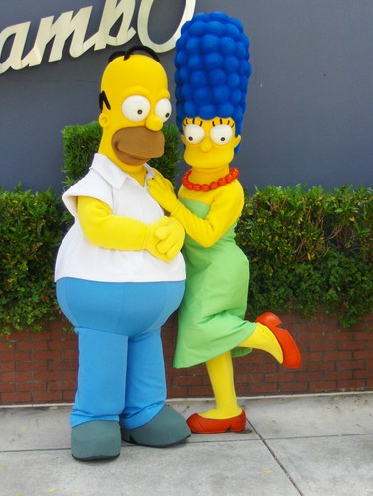

Basics of Machine Learning
Regression
Given X, predict the value of Y
X = heights of parents
Y = height of child at age 10

Slide 5
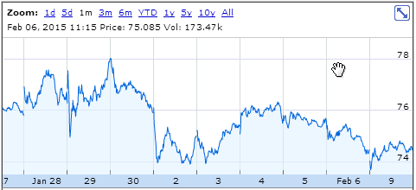
Basics of Machine Learning
Regression
Given X, predict the value of Y
Y = tomorrow’s price
X = stock price history

Slide 6
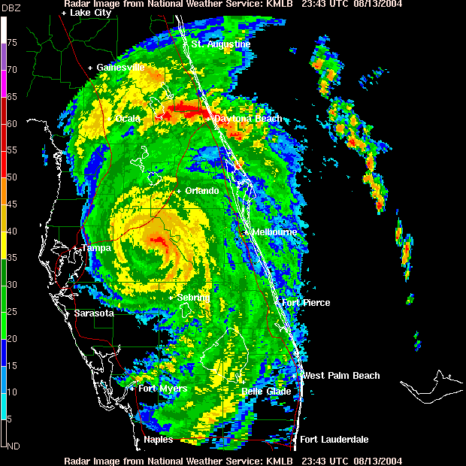
Basics of Machine Learning
Regression
Given X, predict the value of Y
Y = rainfall in inches
X = current Doppler radar

Slide 7
Basics of Machine Learning
Regression
Given X, predict the value of Y
Classification
Given X, predict a binary variable Y

Slide 8

Basics of Machine Learning
Classification
Given X, predict a binary variable Y
Y = fraudulent transactions?
X = credit card transactions

Slide 9
Basics of Machine Learning
Classification
Given X, predict a binary variable Y
Y = will it rain tomorrow?
X = current Doppler radar

Slide 10
Basics of Machine Learning
Regression
Given X, predict the value of Y
Classification
Given X, predict a binary variable Y
Clustering
Given X, find groups/clusters of similar items

Slide 11
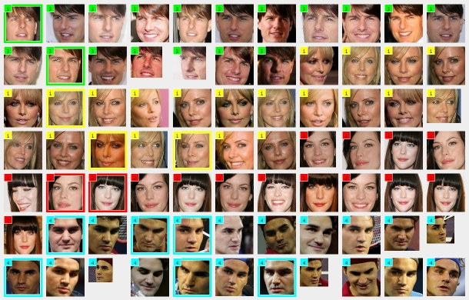
Basics of Machine Learning
Clustering
Given X, find groups/clusters of similar items
Image
clusters
X = image features
http://www.ulrichpaquet.com/prente/face_clustering.jpg

Slide 12
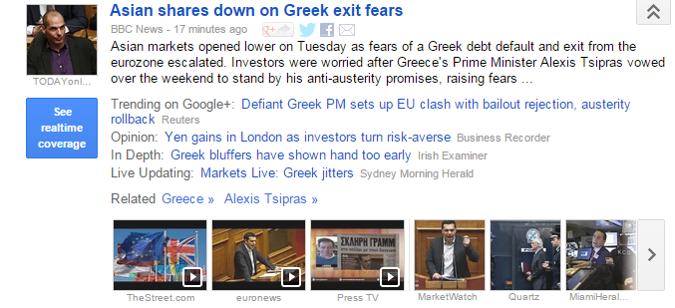
Basics of Machine Learning
Clustering
Given X, find groups/clusters of similar items
Document clusters
X = features of news article
http://news.google.com

Slide 13
Basics of Machine Learning
Regression
Given X, predict the value of Y
Classification
Given X, predict a binary variable Y
Clustering
Given X, find groups/clusters of similar items
and many others…

Slide 14
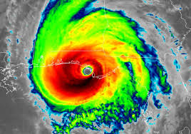

Basics of Machine Learning
Actual physical system
Machine Learning black box
When is Machine Learning not a good idea?

Slide 15
Don’t do ML!
When the laws of the actual system are already relatively well-known and easy to calculate
The actual physics of the weather is known(-ish), and we can just simulate this physics on big computers
Actual physical system

Slide 16
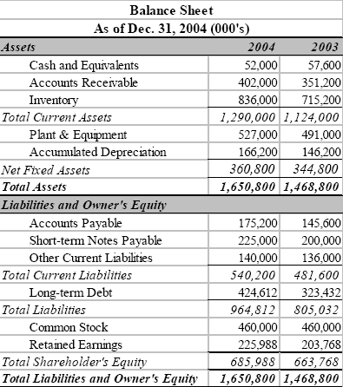
Don’t do ML!
When the laws of the actual system are already relatively well-known and easy to calculate
We already have reasonable rules for this
Example: cash + incoming cash flow > debt maturing soon
Y = bankruptcy in a year?
X = balance sheet and cash flow statement

Slide 17

Don’t do ML!
When actions based on your predictions can change the system
You predict a stock is undervalued and will rise in price
and so you buy 100 shares
This Photo by Unknown Author is licensed under CC BY-SA-NC

Slide 18
Don’t do ML!
When actions based on your predictions can change the system
A “large” fund makes the same prediction
and buys 100M shares
which can distort the market, and change the “actual system”
This Photo by Unknown Author is licensed under CC BY-SA-NC

Slide 19

Don’t do ML!
When you want to understand causality
Prediction: Tylenol reduces fever. Action: Have fever? Just take Tylenol.
Ignores the cause of the fever (the disease)
Predictions are based on correlations, but correlation ≠ causation

Slide 20
Basics of Machine Learning
Don’t do ML
when the laws of the actual system are already relatively well-known and easy to calculate
when actions based on your predictions can change the system
when you want to understand causality
Machine Learning is a good idea when
you have some idea of
what things are related
what things correlate with Y
but you don’t really know how they correlate with Y

Slide 21
Outline
Basics of Machine Learning
Regression
Classification
Clustering
Classification
Steps
Overfitting

Slide 22
Basics of Machine Learning
Classification
Given X, predict a binary variable Y
Y = will customer commit fraud?
X = credit card transactions

Slide 23
Classification
 | Fraction spent on essentials (float) | Number of merchants (int) | Did transactions on e-Bay (boolean)
New Customer 1 | 0.6 | 58 | 0
New Customer 2 | 0.8 | 210 | 1
New Customer 3 | 0.5 | 20 | 0
Fraudulent customer (boolean)
0
1
0
test
Credit card transaction data
Test data (X only)
Predicted y
feature construction
 | Fraction spent on essentials (float) | Number of merchants (int) | Did transactions on e-Bay (boolean)
Customer 1 | 0.2 | 528 | 1
Customer 2 | 0.8 | 20 | 0
Customer 3 | 0.7 | 30 | 0
Customer 4 | 0.8 | 18 | 0
Class label (fraudulent customer or not)
1
0
1
0
Machine Learning Model
train
“Design” matrix (X)
y
Training data

Slide 24
Classification
Many possible models
Naïve Bayes
Nearest Neighbors
Logistic Regression
Decision Trees
Support Vector Machines (SVM)
…
Each model makes its own assumptions

Slide 25
Classification
Examples of model assumptions
Positive class
Negative class
Scatter plot of training data
Feature 2
test point
Feature 1
Locality Assumption: “Predict positive class because similar training points are positive”

Slide 26
Classification
Examples of model assumptions
Feature 2
Feature 2
Feature 1
Feature 1
Locality Assumption
Linear Separator Assumption

Slide 27
Classification
More possibilities under the linearity assumption
Feature 2
Feature 2
Outlier?
Feature 1
Feature 1
Linearity Assumption allowing outliers
Linearity Assumption without outliers

Slide 28
Outline
Basics of Machine Learning
Regression
Classification
Clustering
Classification
Steps
Overfitting

Slide 29
Overfitting
Training Data
Fraud
Safe
credit card transactions
Number of foreign transactions
Number of different merchants
How do we predict fraud versus safe?

Slide 30
Overfitting
Fraud
Safe
Training Data
4 customers misclassified
Number of foreign transactions
Linear separator
Number of different merchants
How do we predict fraud versus safe?

Slide 31
Overfitting
Fraud
Safe
Training Data
2 customers misclassified
Number of foreign transactions
Quadratic separator
Number of different merchants
How do we predict fraud versus safe?

Slide 32
Overfitting
Fraud
Safe
Training Data
0 customers misclassified
Number of foreign transactions
Very complicated separator
Number of different merchants
How do we predict fraud versus safe?

Slide 33
Overfitting
Which classifier should we use?
Linear separator
Simplest
4 classification errors on training data
Quadratic separator
Slightly more complicated than a linear separator (extra params)
2 classification errors on training data
Funky separator
Super complicated
0 mistakes on training data

Slide 34
Overfitting
Why not just minimize misclassifications on training data?
Because we need to be accurate on test data
Training data may be noisy
0 error on training data ➔ accommodating every single noisy datapoint
Won’t help with test data
Number of foreign transactions
Number of foreign transactions
Number of different merchants
Number of different merchants

Slide 35
Overfitting
Why not just minimize misclassifications on training data?
Because we need to be accurate on test data
Training data may be noisy
0 error on training data ➔ accommodating every single noisy datapoint
Won’t help with test data
Problem: We could overfit on the training data
How do we guard against overfitting?
That is, how do we pick the right model class?

Slide 36
Overfitting
Model classes
Changing model parameters
Notes:
Model class should correspond to model “complexity”.

Slide 37
Overfitting
Works only if we know the best model class
Wrong model class ➔ overfitting
How do we pick the right model class?
Parameter fitting
?
Prediction
?
Training data
Fitted model
Testing data

Slide 38
Overfitting
How do we guard against overfitting?
Fit all models
Split the data
Training data
Holdout set

Slide 39
Overfitting
misclassifications on training set (non-holdout)
How do we guard against overfitting?
Fit all models
Low
Split the data
Very Low
Training data
Zero
But we need their misclassification rates on test points
Holdout set

Slide 40
Overfitting
misclassifications on holdout set
How do we guard against overfitting?
Medium
Split the data
Chosen model class
Low
Training data
High
Predict
Holdout set

Slide 41
Overfitting
How do we guard against overfitting?
Fit the chosen model class on the entire training data
Parameter fitting
?
Prediction
?
Training data
Fitted model
Testing data

Slide 42
Overfitting
How do we guard against overfitting?
Holdout set
Minimize misclassifications on the holdout set
Advantages
Avoids overfitting
Overfitting on training data may cause misclassifications on holdout set
Disadvantages
What is the right holdout size?
Too large ➔ wastes data
Too small ➔ the holdout set itself could be noisy

Slide 43
Overfitting
How do we guard against overfitting?
Second idea: Cross-validation
Average over multiple holdout sets
Training data
… split into 3 “folds”
… to form 3 train/holdout sets

Slide 44
Overfitting
How do we guard against overfitting?
Second idea: Cross-validation
Average over multiple holdout sets
Machine Learning Model
Machine Learning Model
Machine Learning Model
Learn
Predict
Learn
Predict
Predict
Learn
Learn

Slide 45
Overfitting
How do we guard against overfitting?
Second idea: Cross-validation
Split training data into 3 parts
For each model class
Train on two parts, and predict on the third
Calculate the average holdout-misclassification
Pick the model class that minimizes this average
3-fold cross-validation
Machine Learning Model
Machine Learning Model
Machine Learning Model
Learn
Predict
Predict
Learn
Learn
Predict
Learn

Slide 46
Overfitting
How do we guard against overfitting?
Second idea: Cross-validation
Average over multiple holdout sets
Advantages
Avoids concerns about any one holdout set being particularly bad just due to randomness
Does not waste any data
Disadvantages
Training using k-fold cross-validation takes k times longer

Slide 47
Classification
Given X, predict a binary variable Y
Convert data to features
Create training data
Create test data
Pick a model
Pick model class via k-fold cross-validation
Once you have chosen the right class:
learn its parameters using the entire training data
Fit the model
Predict results for the test data using the fitted model

Slide 48
A word of warning
Indiscriminate use of cross-validation can be harmful!
Consider a dataset with
50 samples in the training data (e.g., 50 customers using a credit card)
1000 features
You do an extreme kind of cross-validation
Each model class uses just one feature
MC1 ➔ just uses “number of transactions”
MC2 ➔ just uses “fraction of money spent on consumer essentials”
…
1000 model classes
One of these 1000 will doubtless do well

Slide 49
A word of warning
Indiscriminate use of cross-validation can be harmful!
Consider a dataset with
50 samples in the training data (e.g., 50 customers using a credit card)
1000 features
Extreme cross-validation
1000 model classes
How can this be avoided?
An extra holdout set
Just being careful to avoid such situations

Slide 50
Summary
Classification is the art of predicting a binary outcome given features
We have seen the basic mechanics
Training
Testing
Cross-validation

Slide 51
Overfitting
How do we guard against overfitting?
Parameter fitting
Machine Learning Model
Prediction
Testing data
Training data
Usual pipeline

Slide 52
Overfitting
How do we guard against overfitting?
First idea: Holdout set
Learn params
Machine Learning Model
Prediction
Pick model class
Testing data
Predict
For each model class
Fit parameters on “yellow” part
Check accuracy on “green” part
Choose best model class
Fit parameters for this model class on entire training set (green + yellow)
Training data
Holdout set

